Slide 1

Derivatives
Definition of derivatives
A derivative is a financial instrument that derives its value from the performance of an underlying asset.

Slide 2

Derivatives
TYPES OF DERIVATIVES
Primary derivative types include a firm(forward) commitment in which a predetermined amount is agreed to be exchanged between counterparties at settlement and a contingent claim in which one of the counterparties determines whether and when the trade will settle.

Slide 3

Forward
Forward commitments
Forward
Futures
Swap
Contingent claims
Option
Credit Derivatives

Slide 4
Forward
Definition: A forward contract is an over-the-counter (OTC) derivative in which two counterparties agree that one counterparty, the buyer, will purchase an underlying from the other counterparty, the seller, in the future at a pre-agreed fixed price.
These markets are known as cash markets or spot markets in which specific assets are exchanged at current prices referred to as cash prices or spot prices.
At time t = 0, the counterparties do not exchange a payment upfront but, rather, agree on delivery of the underlying at time T for a forward price of F₀(T).

Slide 5
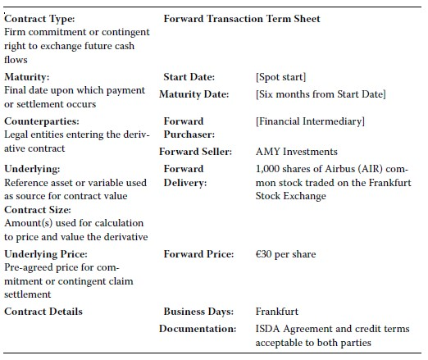
example

Slide 6
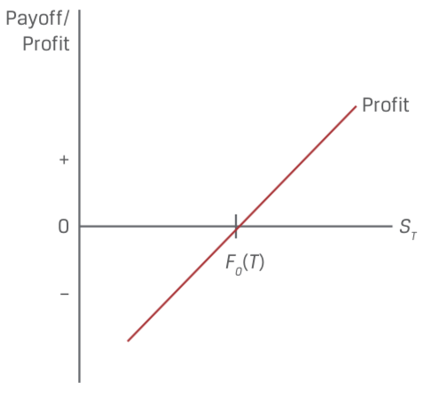
Forward
Long Forward Payoff Profile
Buyer Payoff = S_{T}-F₀(T)

Slide 7
Forward
Characteristics:
An important element of forward contracts is that no money changes hands between parties when the contract is initiated.
The long and the short are engaged in a zero- sum game, which is a type of competition in which one participant’s gains are the other’s losses.
Forward contracts have zero value at the start.
Forward contracts need not specifically settle by delivery of the underlying asset. They can settle by an exchange of cash. These contracts—called non- deliverable forwards (NDFs), cash- settled forwards, or contracts for differences.

Slide 8

example
An investor, Procam Investments, enters a cash-settled forward contract with a financial intermediary to buy 100 ounces of gold at a forward price, F0(T), of $1,792.13 per ounce in three months.
Today’s spot gold price (S0) is $1,770 per ounce.
At contract maturity, the gold price (ST) is $1,780.50 per ounce.

Slide 9
practices
1. Describe a scenario in which a forward contract has cash settlement of zero at maturity and neither counterparty has defaulted.
2. Determine the correct answers to fill in the blanks: An oil producer enters a derivative contract with an investor to sell 1,000 barrels of oil in two months at a forward price of $64 per barrel. If the spot oil price at maturity is $58.50 per barrel, the investor realizes a __________ at maturity equal to __________.

Slide 10
practices
A. Forward contract purchaser
B. Forward contract seller
C. Neither a forward contract purchaser nor a seller
1. Seeks to benefit from underlying price depreciation
2. Realizes a gain if the initial spot price of the underlying, S0, exceeds the forward price of F0(T)
3. Receives a positive payoff at maturity if the spot price, ST, exceeds the forward price of F0(T)

Slide 11

Futures
Forward commitments
Forward
Futures
Swap
Contingent claims
Option
Credit Derivatives

Slide 12

Futures
Definition: Futures contracts are forward contracts with standardized sizes, dates, and underlying that trade on futures exchanges.
The futures contract buyer creates a long exposure to the underlying by agreeing to purchase the underlying at a later date at a pre-agreed price. The seller makes the opposite commitment. This agreed-on price is called the futures price, f0(T).

Slide 13
Futures
Probably the most important distinctive characteristic of futures contracts is the daily settlement of gains and losses and the associated credit guarantee provided by the exchange through its clearinghouse.
At the end of each day, the clearinghouse engages in a practice called mark to market, also known as the daily settlement.
The account is specifically referred to as a margin account.
Initial margin
Maintenance margin
Margin call
Variation margin

Slide 14
example
Futures price=5.5,quantity=20,initial margin=11,maintenance margin=6
 | Beginning Balance | Fund Deposit | Futures( settlement) price | Gain/Loss | Ending Balance
Day 0 | 0 | 11 | 5.5 | 0 | 11
Day 1 | 11 | 0 | 5.4 | -2 | 9
Day 2 | 9 | 0 | 5.2 | -4 | 5
Day 3 | 5 | 6 | 5.0 | -4 | 7
Day 4 | 7 | 0 | 5.1 | 2 | 9
Day 5 | 9 | 0 | 4.9 | -4 | 5
Day 6 | 5 | 6 | 5.0 | 2 | 13

Slide 15
Futures
Characteristics:
Futures exchanges are highly regulated at the national level in all countries.
By standardizing these contracts and creating an organized market with rules, regulations, and a central clearing facility, the futures markets offer an element of liquidity and protection against loss by default.
An exchange may increase required margins and/or make margin calls on an intraday basis.
Some futures contracts also limit daily price changes. These rules, called price limits, establish a band relative to the previous day’s settlement price within which all trades must occur.

Slide 16
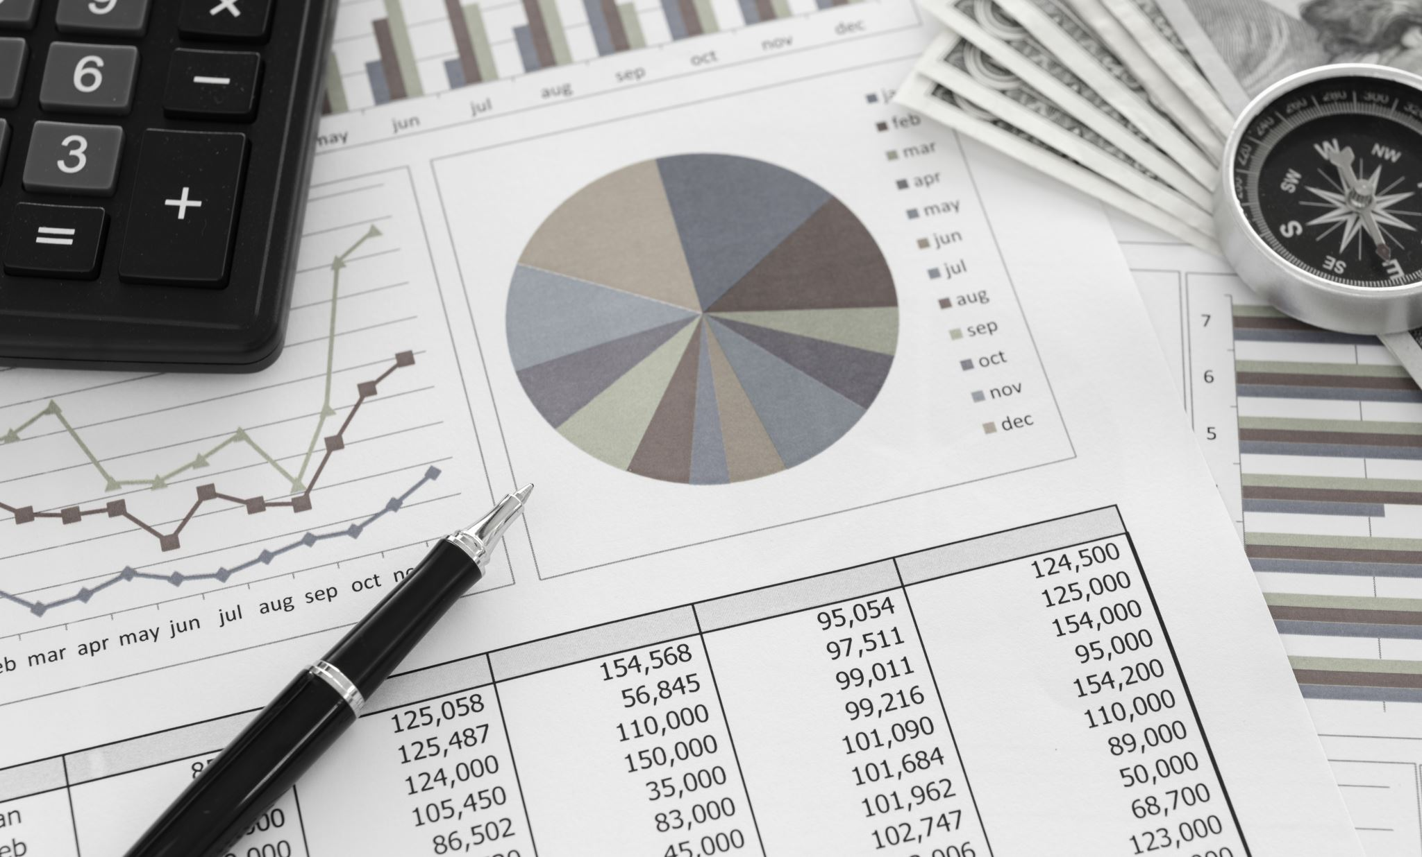
Futures
Futures contracts specify whether physical delivery of an underlying or cash settlement occurs at expiration.
At any given time, the number of outstanding contracts is called the open interest.
The futures price converges to the spot price at expiration.

Slide 17
Futures
Difference between forward and futures
Forward | Futures
More privacy/Less regulated | Highly regulated
 | More transparent
More flexibility
More customized | Standardized
Settle at expiration | Daily settlement
 | Credit guarantee(Margin account)

Slide 18
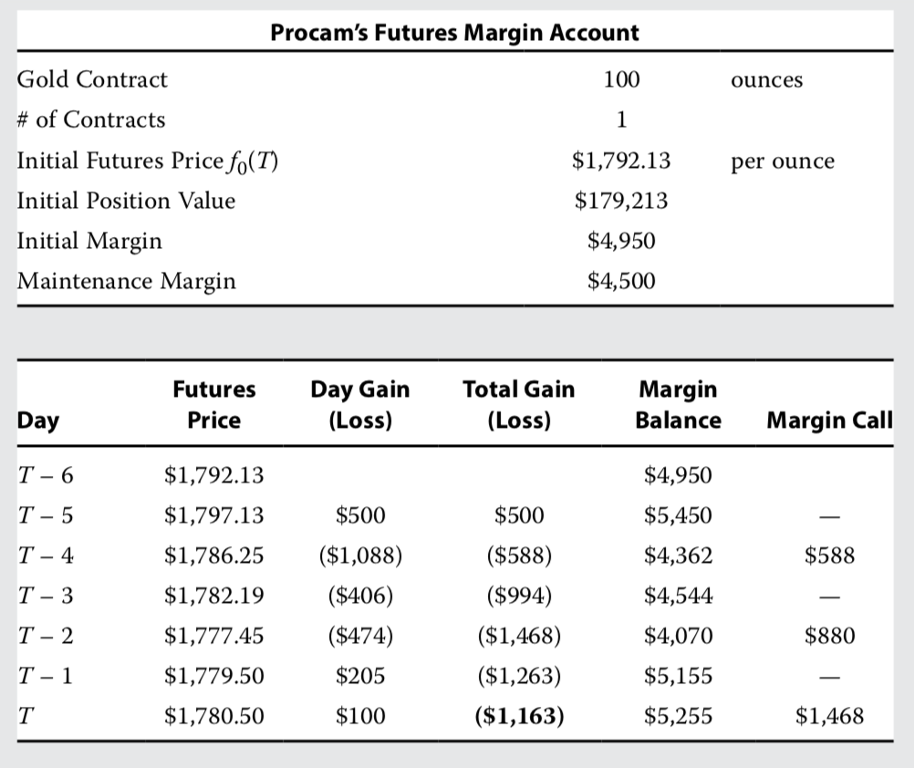
example
Procam purchases a futures contract [f0(T) = $1,792.13] on the exchange via a financial intermediary.

Slide 19
practices
A. Futures contract purchaser
B. Futures contract seller
C. Both a futures contract purchaser and a seller
1. Must make a margin deposit at contract initiation and maintain a minimum balance until maturity
2. Receives a margin account deposit if the futures price increases on any trading day
3. Receives a positive payoff if the spot price ST is below the futures price, f0(T), at maturity

Slide 20

Swap
Forward commitments
Forward
Futures
Swap
Contingent claims
Option
Credit Derivatives

Slide 21
Swap
Definition: A swap is a firm commitment under which two counterparties exchange a series of cash flows in the future. One set of cash flows is typically variable, or floating, and determined by a market reference rate that resets each period. The other cash flow stream is usually fixed or may vary based on a different underlying asset or rate.

Slide 22
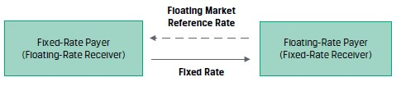
Swap
Plain vanilla swap: the most common swap is the fixed- for- floating interest rate swap.

Slide 23
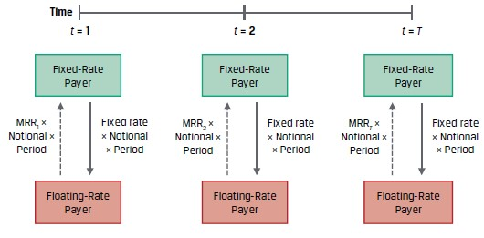
Swap
Counterparties usually exchange a net payment on fixed- and floating-rate payments

Slide 24
example
Fyleton Investments has entered a five-year, receive-fixed GBP200 million interest rate swap with a financial intermediary to increase the duration of its fixed-income portfolio. Under terms of the swap, Fyleton has agreed to receive a semiannual GBP fixed rate of 2.25% and pay six-month MRR.
Calculate the first swap cash flow exchange if six-month MRR is set at 1.95%.

Slide 25
Swap
Characteristics
A swap is more or less just a series of forwards.
A swap is a bit more like a forward contract than a futures contract in that it is an OTC contract, so it is privately negotiated and subject to default.
The party owing the lesser amount cannot default to the party owing the greater amount.
As with futures and forwards, no money changes hands at the start; thus, the value of a swap when initiated must be zero.
The notional amount of a swap is not typically exchanged, the credit risk of a swap is much less than that of a loan.

Slide 26
practices
1.Which of the following characterizes forward contracts and swaps but not futures?
A They are customized.
B They are subject to daily price limits.
C Their payoffs are received on a daily basis.
2.Which of the following distinguishes forwards from swaps?
A Forwards are OTC instruments, whereas swaps are exchange traded.
B Forwards are regulated as futures, whereas swaps are regulated as securities.
C Swaps have multiple payments, whereas forwards have only a single payment.

Slide 27
practices
A. Fixed rate payer
B. Floating rate payer
C. Both a fixed rate payer and a floating rate payer
1. Makes a payment each interest period based on a market reference rate
2. May face a positive or a negative mark to market over the life of an interest rate swap contract
3. Receives a net payment on the swap for any interest period for which the market reference rate exceeds the fixed rate

Slide 28
Option
Forward commitments
Forward
Futures
Swap
Contingent claims
Option
Credit Derivatives

Slide 29
Call Option
Long：花钱获得一个权力
Short：收钱卖出一个权力
Call option: The right to buy an underlying.
Long call:花钱（请老板吃饭）获得一个买资产（买可乐）的权力
Short call:收钱（被请吃饭）卖出一个买资产（买可乐）的权力
 | right | obligation
我 | long call
杂货店老板 |  | short call

Slide 30
Call Option
The right to exercise in the future has a value that is paid upfront to the option seller in the form of an option premium.
The pre-agreed execution price is called the exercise price (or strike price).

Slide 31
Call Option
Payoff of call option
Long call = MAX (S_{T}-X,0)
Short call = - MAX (S_{T}-X,0)
Profit of call option
Long call = MAX (S_{T}-X,0) – C₀
Short call = - MAX (S_{T}-X,0) + C₀

Slide 32
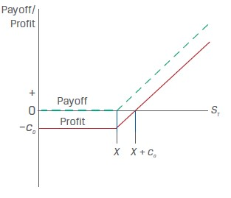
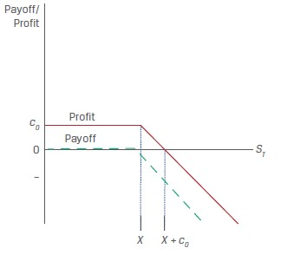
Call Option
Payoff and profit of short call
Payoff and profit of long call

Slide 33
Practices
Hightest Capital purchases a call option on the S&P 500 Health Care Select
Sector Index (SIXV). This six-month exchange-traded option contract has a
size of 100 index units and an exercise price of $1,240 per unit versus the initial
SIXV spot price of $1,180.95. The option premium paid upfront is $24.85
per unit, or $2,485 (= $24.85 × 100). As the option nears maturity, a Hightest
analyst is asked to determine the expected option payoff and profit per unit at
maturity under different scenarios for the SIXV spot price on the exercise date.

Slide 34
Practices
S_{T} | payoff | profit
1,260
1,220
Calculate the SIXV spot price at maturity from Practices at which Hightest Capital will reach a breakeven point and earn zero profit.

Slide 35
Put Option
Long:花钱获得一个权力
Short:收钱卖出一个权力
Put option: The right to sell the underlying.
Long put:花钱（喝酒）买入一个卖资产（卖可乐）的权力
Short put:收钱（喝酒）卖出一个卖资产（卖可乐）的权力
 | right | Obligation
杂货店老板 | long put
小柏 |  | short put

Slide 36
Put Option
Payoff of put option
Long put = MAX (X-S_{T},0)
Short put = - MAX (X-S_{T},0)
Profit of put option
Long put = MAX (X-S_{T},0) – P₀
Short put = - MAX (X-S_{T},0) + P₀

Slide 37
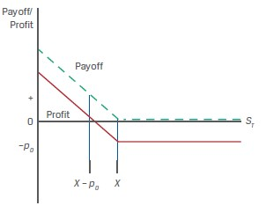
Put Option
Payoff and profit of long put

Slide 38
Option
Characteristics：
Options that can be exercised early are referred to as American- style.
Options that can be exercised only at expiration are referred to as European- style.
Thus, only the short can default, which would occur if the long exercises the option and the short fails to do what it is supposed to do.
This asymmetric payoff profile is a common feature of contingent claims, which are sometimes referred to as non-linear derivatives.
An option’s value is primarily made up of two distinct parts: its intrinsic value and time value.

Slide 39
Option
Moneyness | In the money | Out of the money | At the money
Call option | S_{t}>X | S_{t}<X | S_{t}=X
Put option | S_{t}<X | S_{t}>X | S_{t}=X
In the money(价内期权，实值期权): when the buyer will exercise the option
Out of the money(价外期权，虚值期权) : when the buyer will not exercise the option
At the money : when the option payoff is zero to the buyer

Slide 40
Option
Definition: An option is a derivative contract in which one party, the buyer, pays a sum of money to the other party, the seller or writer, and receives the right to either buy or sell an underlying asset at a fixed price either on a specific expiration date or at any time prior to the expiration date.

Slide 41
Practices
A put option seller receives a $5 premium for a put option sold on an underlying with an exercise price of $30. What is the option seller’s maximum profit under the contract? What is the maximum loss under the contract?

Slide 42
practices
A. Put option seller
B. Call option seller
C. Both a put option seller and a call option seller
1. Has no counterparty credit risk to the option buyer once the upfront premium has been paid
2. Earns a profit equal to the premium if the underlying price at maturity is less than the exercise price
3. Earns a profit equal to the premium if the underlying price at maturity exceeds the exercise price

Slide 43
credit derivatives
Forward commitments
Forward
Futures
Swap
Contingent claims
Option
Credit Derivatives

Slide 44
Credit Derivatives
Definition : A credit derivative is a class of derivative contracts between two parties, a credit protection buyer and a credit protection seller, in which the latter provides protection to the former against a specific credit loss.
Buyer:面临信用风险，买入信用衍生品，获得信用保护
债券持有人，发放贷款机构
Seller:卖出信用衍生品，提供信用保护
各类金融机构（保险公司，券商）

Slide 45
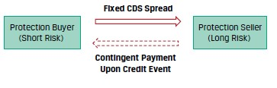
Credit Derivatives
Definition: a credit default swap is a derivative contract between two parties, a credit protection buyer and a credit protection seller, in which the buyer makes a series of cash payments to the seller and receives a promise of compensation for credit losses resulting from the default of a third party.

Slide 46

Credit Derivatives
Characteristics:
Credit spreads depend on the probability of default (PD) and the loss given default (LGD).
This contingent payment equals the issuer loss given default for the CDS contract notional amount.
A credit protection buyer without the corresponding fixed-income exposure who
buys a CDS is seeking to gain from higher credit spreads (which correspond to lower
cash bond prices) for an underlying issuer and is therefore short credit risk.

Slide 47
practices
Describe how a credit protection seller’s position is similar to that of an underlying cash bond investment.
A. Credit protection buyer
B. Credit protection seller
C. Both a credit protection buyer and a credit protection seller
1. Seeks to gain from higher issuer credit spreads
2. Enters into a derivative contract that transfers the risk of loss from a credit event of an underlying third-party issuer
3. Faces an MTM gain on the CDS contract if the CDS spread of the underlying issuer falls

Slide 48
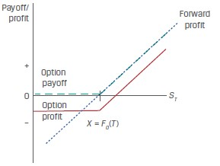
Forward commitment and contingent claim
Long forward and long call option payoff profile
S_{T}-F₀(T)>-C₀ | Forward profit exceeds option profit
S_{T}-F₀(T)=-C₀ | Forward profit equals option profit
S_{T}-F₀(T)<-C₀ | Option profit exceeds forward profit
The long call option’s similarity to a long position in the underlying with downside protection in exchange for paying a premium.

Slide 49
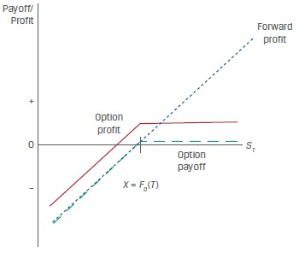
Forward commitment and contingent claim
Long forward and short put option payoff profile
S_{T}-F₀(T)>p₀ | Forward profit exceeds option profit
S_{T}-F₀(T)=p₀ | Forward profit equals option profit
S_{T}-F₀(T)<p₀ | Option profit exceeds forward profit
The sold put option’s similarity to a long position in the underlying, with gains from price appreciation forgone in exchange for receiving a premium.

Slide 50
practices
Biomian Limited is a Mumbai-based biotech company with common stock and listed futures and options on the National Stock Exchange (NSE). The Viswan Family Office (VFO) currently owns 10,000 Biomian common shares. VFO would like to reduce its long Biomian position and diversify its equity market exposure but will delay a cash sale of shares for tax reasons for six months.

Slide 51
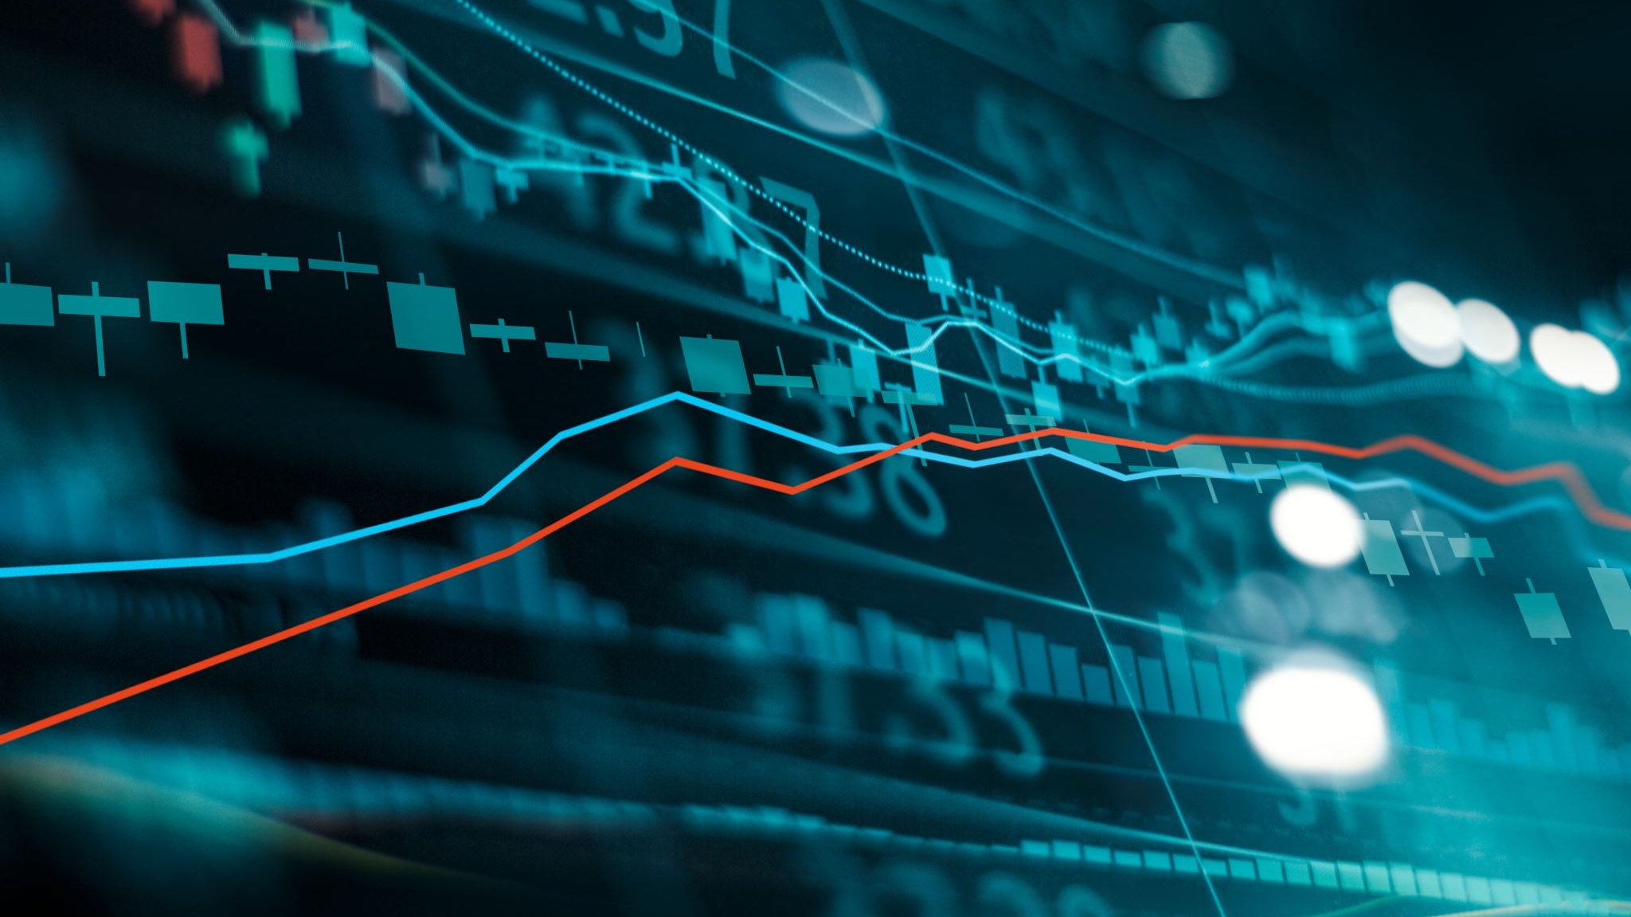
practices
1. Which of the following derivative contracts available to VFO’s chief investment officer is best suited to reduce exposure to a decline in Biomian’s stock price in the next six months?
A. A short put position on Biomian stock that expires in six months
B. A long call position on Biomian stock that expires in six months
C. A short futures position in Biomian stock that settles in six months
2. VFO’s market strategist believes that Biomian’s share price will rise over the next six months but would like to protect against a decline in Biomian’s share price over the period. Which of the following positions is best suited for VFO to manage its existing Biomian exposure based on this view?
A. A long put position on Biomian stock that expires in six months
B. A short call position on Biomian stock that expires in six months
C. A long futures position in Biomian stock that settles in six months

Slide 52
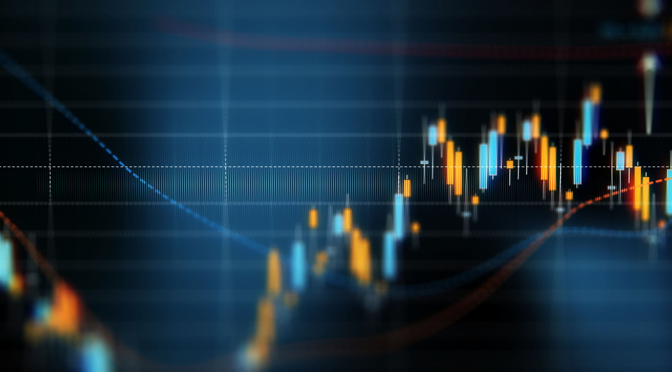
practices
3. Assume that Biomian shares rise over the next six months. Which of the following statements about VFO’s derivative strategies under this scenario is most accurate?
A. A forward sale of Biomian shares in six months would be more profitable
than purchasing the right to sell Biomian shares in six months.
B. Purchasing the right to sell Biomian shares in six months would be more
profitable than a forward sale of Biomian shares in six months.
C. We do not have enough information to determine whether a forward sale or
the right to sell Biomian shares will be more profitable in six months.

Slide 53
practices
4. VFO’s market strategist is considering a six-month call option strategy on the
NIFTY 50 benchmark Indian stock market index to increase broad market equity
exposure. The NIFTY 50 price today is INR15,200, and the strategist observes
that a call option with a INR16,000 exercise price (X) is trading at a premium of
INR1,500. Which of the following represents the payoff and profit of this strategy
just prior to maturity if the NIFTY 50 is trading at INR16,500?
A. Payoff is INR500; profit is –INR1,000.
B. Payoff is INR1,300; profit is INR800.
C. Payoff is INR1,300; profit is INR500.

Slide 54
Pricing and valuation of derivatives
Pricing and valuation of forward
Forward rate agreement
Pricing and valuation of futures
Pricing and valuation of swap
Pricing and valuation of option
Put-call parity
One-period binominal model

Slide 55
Pricing and valuation of forward
The forward, futures, or swap pricing is a concept that represents the fixed price or rate at which the underlying will be purchased at a later date.
Opportunity cost (risk-free interest rate, r)
Other costs of ownership (C):Owners of some underlying assets, such as physical commodities, must incur storage, transportation, insurance, and/or spoilage costs.
Benefits of ownership (B):Stock dividends or bond coupons are examples of cash flow benefits.

Slide 56
Pricing and valuation of forward
For underlying assets with ownership benefits or benefit (B) or costs (C) expressed as a known amount in present value terms at t = 0—shown as PV()₀—the relationship between spot and forward prices in discrete compounding terms can be shown as
F_{T}=S₀*(1+r)^{T}
F_{T}=(S₀+PVC₀-PVB₀)*(1+r)^{T}

Slide 57
practices
Assume Hightest Capital agrees to deliver 1,000 Unilever (UL) shares at an agreed-upon price to a financial intermediary in six months under a forward contract. Assume that UL has a spot price (S0) of EUR50 and pays a quarterly dividend of EUR0.30, which occurs in exactly three months and again at time T, and assume a risk-free rate (r) of 5%.

Slide 58
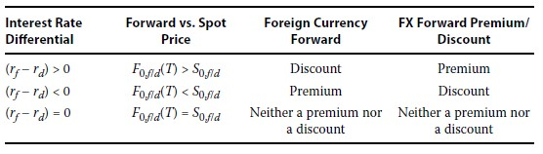
Pricing and valuation of forward
fc/dc, price currency/base currency
USD/EUR=1.2 USD1.2=EUR1
A long FX forward position involves the purchase of the base currency and the sale of the price currency.
F₀,_{f/d}(T)=S₀,_{f/d}*e^{(r}_{f}^{-r}_{d}^{)T}

Slide 59
practices
Assume the current AUD/USD spot price is 1.3335. The Australian dollar is the price currency or foreign currency, and the US dollar is the base or domestic currency (AUD1.3335 = USD1). The six-month Australian dollar risk-free rate is 0.05%, and the six-month US dollar risk-free rate is 0.20%.

Slide 60
Pricing and valuation of forward
This mark-to-market value of a contract reflects the change in the underlying price and other factors that would result in a gain or loss to a counterparty if the forward contract were to be settled immediately.
Pricing and Valuation of Forward Contracts at Initiation:
V₀(T) = 0
Pricing and Valuation of Forward Contracts at Maturity:
V_{T}(T) = S_{T} − F₀(T)

Slide 61
Pricing and valuation of forward
The mark-to-market value of a contract at any point in time from inception to maturity, Vt(T), reflects the relationship between the current spot price at time t (St) and the present value of the forward price at time t discounted at the current risk-free rate.
Pricing and Valuation of Forward Contracts during the Life of the Contract:
V_{t}(T) = S_{t} − F₀(T)(1 + r)^{-(T-t)}
Pricing and Valuation of Forward Contracts with Additional Costs or Benefit:
V_{t}(T) = (S_{t}+ PVC_{t} –PVB_{t}) − F₀(T)(1 + r)^{-(T-t)}

Slide 62
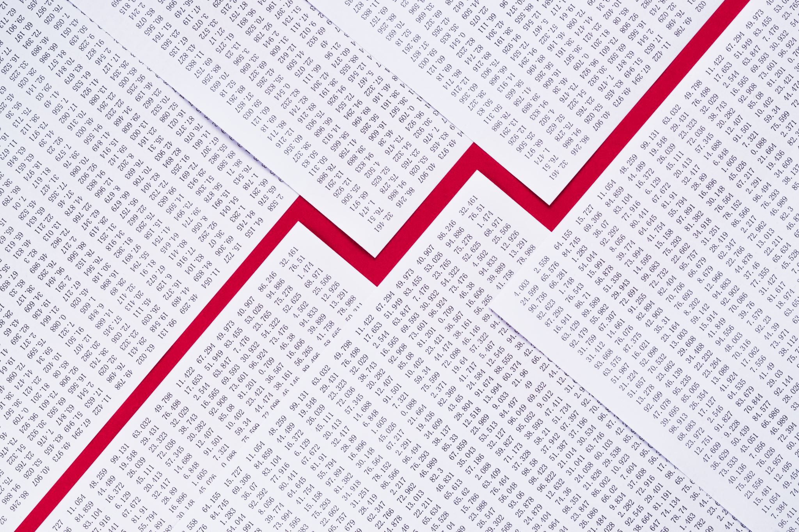
practices
VFO enters into a six-month forward contract with a financial intermediary to sell Biomian shares at F0(T) = INR300.84 per share. The spot price at t = 0 is INR295 per share and the risk-free rate is 4%.
1. Calculate the forward contract MTM from VFO’s perspective in three months (t = 0.25) if Biomian’s spot price (St) falls to INR285 per share.
2. Show the forward contract MTM from VFO’s perspective in Question (1) if the risk-free rate doubles from 4% to 8%, and interpret the results.

Slide 63
practices
Hightest Capital agreed to deliver 1,000 Unilever (UL) shares to a financial intermediary in six months under a forward contract at a price of EUR 50,631.10, or EUR 50.6311 per share. Unilever pays a quarterly dividend of EUR 0.30 three months after contract inception and at time T, and the risk-free rate (r) is 5%. Calculate the forward contract breakeven price, St, where Vt(T) = MTM = 0 four months after contract inception if the risk-free rate, r, remains unchanged at 5%.

Slide 64
Pricing and valuation of forward
At any given time t, the MTM value of the FX forward is the difference between the current spot FX price (St,f/d) and the present value of the forward price discounted by the current difference in risk-free rates (rf − rd) for the remaining period through maturity.
V_{t}(T) = S_{t},_{f/d} − F₀,_{f/d}(T)e^{-(r}_{f}^{–r}_{d}^{)(T–t)}

Slide 65
practices
Rook Point Investors LLC has entered into a long one-year USD/EUR forward contract. That is, it has agreed to purchase EUR1,000,000 in exchange for USD1,201,000 in one year. At time t = 0 when the contract is initiated, the USD/EUR spot exchange rate is 1.192 (i.e., USD1.192 = EUR1), the one-year USD risk-free rate is 0.50%, and the one-year EUR risk-free rate is −0.25%.
Describe the MTM impact on the FX forward contract from Rook Point’s perspective if the one-year USD risk-free rate instantaneously rises by 0.25% once the contract is initiated, with other details unchanged.

Slide 66
Pricing and valuation of derivatives
Pricing and valuation of forward
Forward rate agreement
Pricing and valuation of futures
Pricing and valuation of swap
Pricing and valuation of option
Put-call parity
One-period binominal model

Slide 67
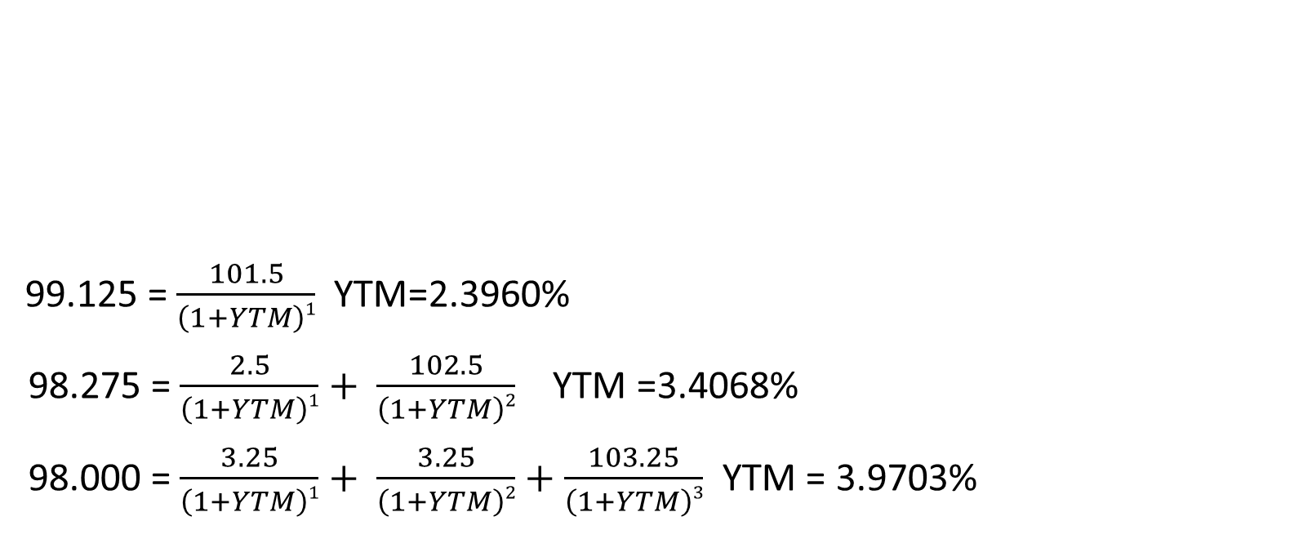
Forward rate agreement
99.125 = $\frac{101.5}{\left(1+YTM\right)1}$YTM=2.3960%
98.275 = $\frac{2.5}{\left(1+YTM\right)1}+ \frac{102.5}{\left(1+YTM\right)2}$ YTM =3.4068%
98.000 = $\frac{3.25}{\left(1+YTM\right)1}+ \frac{3.25}{\left(1+YTM\right)2}+\frac{103.25}{\left(1+YTM\right)3}$ YTM = 3.9703%
Years to maturity | Annual coupon | PV(per 100 FV)
1 | 1.50% | 99.125
2 | 2.50% | 98.275
3 | 3.25% | 98.000

Slide 68
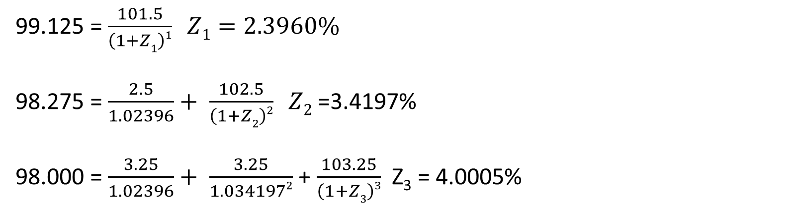
Forward rate agreement
Years to maturity | Annual coupon | PV(per 100 FV) | YTM
1 | 1.50% | 99.125 | 2.3960%
2 | 2.50% | 98.275 | 3.4068%
3 | 3.25% | 98.000 | 3.9703%
99.125 = $\frac{101.5}{\left(1+Z1\right)1} Z1=2.3960\%$
98.275 = $\frac{2.5}{1.02396}+ \frac{102.5}{\left(1+Z2\right)2} Z2$ =3.4197%
98.000 = $\frac{3.25}{1.02396}+ \frac{3.25}{1.0341972}$ + $\frac{103.25}{\left(1+Z3\right)3}$ Z₃ = 4.0005%

Slide 69
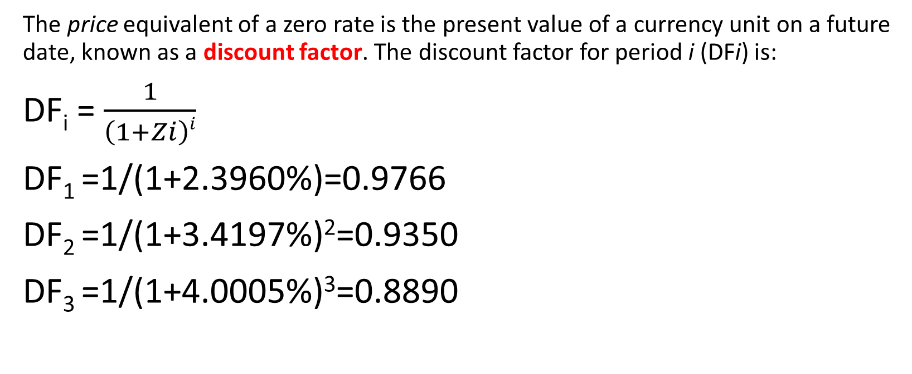
Forward rate agreement
The price equivalent of a zero rate is the present value of a currency unit on a future date, known as a discount factor. The discount factor for period i (DFi) is:
DF_{i} = $\frac{1}{\left(1+Zi\right)i}$
DF₁ =1/(1+2.3960%)=0.9766
DF₂ =1/(1+3.4197%)²=0.9350
DF₃ =1/(1+4.0005%)³=0.8890

Slide 70
Forward rate agreement
The breakeven reinvestment rate linking a short-dated and a long-dated zero-coupon bond is an implied forward rate (IFR).
(1+Z_{A})^{A} * (1+IFR_{A,B-A})^{B-A} =(1+Z_{B})^{B}
Years to maturity | Zero rate
1 | 2.3960%
2 | 3.4197%
3 | 4.0005%
IFR_{1,1} (1+2.3960%)*(1+IFR_{1,1})=(1+3.4197%)² IFR_{1,1}=4.4536%
IFR_{2,1} (1+3.4197%)²*(1+IFR_{2,1})=(1+4.0005%)³ IFR_{2,1}=5.1719%

Slide 71
Forward rate agreement
Assume, for example, that today we observe a current three-month MRR of 1.25% and a current six-month MRR of 1.75%. How can we solve for the three-month implied forward MRR in three months’ time (IFR3m, 3m)?
(1+APR₄/4)⁴=(1+0.0175/2)²
APR₄=1.74619%
(1+Z_{3m}/4)*(1+IFR_{3m,3m}/4)=(1+Z_{6m}/4)²
IFR_{3m,3m}=2.24299%

Slide 72
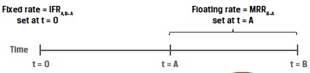
Forward rate agreement
An OTC derivatives contract in which counterparties agree to apply a specific interest rate to a future period is a forward rate agreement (FRA).
The FRA buyer, or long position, agrees to pay the deposit interest based on the agreed upon fixed rate and receives deposit interest based on a market reference rate that begins in A periods and ends in B periods (with a tenor of B − A periods) and is determined on or just before the forward settlement date at time t = A.

Slide 73
practices
A counterparty agrees to be the FRA fixed-rate receiver on a one-month AUD MRR in three months’ time based on a AUD150,000,000 notional amount. If IFR3m,1m at contract inception is 0.50% and one-month AUD MRR sets at 0.35% for settlement of the contract, calculate the settlement amount and interpret the results.

Slide 74
practices
A client seeking advice on her fixed-income portfolio observes the price and yield-to-maturity of one-year (r1) and two-year (r2) annual coupon government benchmark bonds currently available in the market. Which of the following statements best describes how the analyst can determine a breakeven reinvestment rate in one year’s time to help decide whether to invest now for one or two years?
A. As the two-year rate involves intermediate cash flows, divide the square root of (1 + r2) by (1 + r1) and subtract 1 to arrive at a breakeven reinvestment rate for one year in one year’s time.
B. Since the first year’s returns are compounded in the second year, set (1 + r1) multiplied by 1 plus the breakeven reinvestment rate equal to (1 + r2)² and solve for the breakeven reinvestment rate.
C. Since the breakeven reinvestment involves a zero-coupon cash flow, first substitute the one-year rate (r1) into the two-year bond price equation to solve for the two-year spot or zero rate (z2), then set (1 + r1) × (1 + breakeven reinvestment rate) = (1 + z2)² and solve for the breakeven reinvestment rate.

Slide 75
practices
Baywhite Financial seeks to gain a competitive advantage by making margin loans at fixed rates for up to 60 days to its investor clients. Since Baywhite borrows at a variable one-month market reference rate to finance these client loans, the firm enters into one-month FRA contracts on one-month MRR to hedge the interest rate exposure of its margin loan book. Which of the following statements best describes Baywhite’s interest rate exposure and the FRA position it should take to hedge that exposure?
A. Baywhite faces exposure to a rise in one-month MRR over the next 30 days, so it should enter into the FRA as a fixed-rate payer in order to benefit from a rise in one-month MRR above the FRA rate and offset its higher borrowing cost.
B. Baywhite faces exposure to a rise in one-month MRR over the next 30 days, so it should enter into the FRA as a fixed-rate receiver in order to benefit from a rise in one-month MRR above the FRA rate and offset its higher borrowing cost.
C. Baywhite faces exposure to a decline in one-month MRR over the next 30 days, so it should enter into the FRA as a fixed-rate receiver in order to benefit from a rise in one-month MRR above the FRA rate and offset its higher borrowing cost.

Slide 76
Pricing and valuation of derivatives
Pricing and valuation of forward
Forward rate agreement
Pricing and valuation of futures
Pricing and valuation of swap
Pricing and valuation of option
Put-call parity
One-period binominal model

Slide 77

Pricing and valuation of futures
The futures price, f₀(T), is identical to the forward price from a previous lesson.
f₀(T)=S₀(1+r)^{T}
f₀(T)=[S₀+PVC₀-PVB₀ ](1+r)^{T}
f₀(T)=S₀e^{rT}
f₀(T)=S₀e^{(r+C-B)T}

Slide 78
Pricing and valuation of futures
The different patterns of cash flows for forwards and futures can lead to a difference in the pricing of forwards versus futures. Forward and futures prices are identical under certain conditions, namely:
■ if interest rates are constant, or
■ if futures prices and interest rates are uncorrelated.
If futures prices are positively correlated with interest rates, long futures contracts are more attractive than long forward positions for the same underlying and maturity.
A negative correlation between futures prices and interest rates leads to the opposite interpretation, with long forward positions being more desirable than long futures positions.

Slide 79
Pricing and valuation of futures
Procam Investments enters a cash-settled forward commitment to buy 100 ounces of gold at a price (f₀[T] = F₀[T]) of $1,778.76 per ounce in 91 days, with a risk-free rate of 2% and no gold storage cost.
Assume that the gold futures price, f₁(T), falls by $5 on the first trading day to $1,773.76 and the spot price, S₁, ends the day at a no arbitrage equivalent of $1,765.12 (= $1,773.76(1.02)^{–90/365}).
Contract type | Contract MTM | Realized MTM
Forward | -497.56 | 0
Futures | 0 | -500

Slide 80
Pricing and valuation of futures
Characteristics:
The forward contract price, F₀(T), remains fixed until the contract matures.
Forward contract MTM value changes are captured by the difference between the current spot price, S_{t}, and the present value of the forward price, PV_{t}[F₀(T)].
This forward contract MTM is not settled until maturity, giving rise to counterparty credit risk over time since no cash is exchanged from inception of the contract to its maturity or expiration.
Futures contract prices fluctuate daily based upon market changes.
The daily settlement mechanism resets the futures MTM to zero, and variation margin is exchanged to settle the difference, reducing counterparty credit risk.

Slide 81
Pricing and valuation of futures interest rate futures
f_{A,B−A} = 100 − (100 × MRR_{A,B−A})
Where f_{A,B-A} represents the futures price for a market reference rate for B-A periods that begins in A periods (MRR_{A,B-A})
f3m,3m : 98.25 = 100-(100*MRR_{3m,3m})
MRR_{3m,3m}=1.75%

Slide 82
Pricing and valuation of futures interest rate futures
Contract type | Gains from rising MRR(borrower) | Gains from falling MRR(lender)
Interest rate futures | Short futures contract | Long futures contract
FRA | Long FRA Fixed-rate payer Floating-rate receiver | Short FRA Fixed-rate receiver Floating-rate payer

Slide 83
Pricing and valuation of futures interest rate futures
Interest rate futures daily settlement occurs based on price changes, which translate into futures contract basis point value (BPV) as follows:
Futures Contract BPV = Notional Principal × 0.01% × Period
If Baywhite were to use an interest rate futures contract instead, it would sell a futures contract on one-month MRR. The futures contract BPV for a $50,000,000 notional amount is:
Contract BPV = $416.67 (= $50,000,000 × 0.01% × [1/12])
If Baywhite sells f_{1,1} for $98.75 (or MRR_{1,1} = 1.25%) and settles at maturity at a price of $97.75 (MRR_{1,1} = 2.25%), it would expect to have a cumulative gain on the contract through maturity equal to $41,667 (= Contract BPV × 100 bps).

Slide 84
Pricing and valuation of futures interest rate futures
MRR_{3m,3m} | Short FRA cash settlement(PV) | Long futures settlement
2.01% | 497.50 | 500
2.11% | 248.69 | 250
2.21% | 0 | 0
2.31% | -248.56 | -250
2.41% | -497.01 | -500
An interest rate futures contract of $1,000,000 notional for three-month MRR of 2.21% for one quarter (or 90/360 days).
BPV=1,000,000*0.01%*0.25=25
Consider in contrast a $1,000,000 notional FRA on three-month MRR in three months’ time with an identical 2.21% rate.

Slide 85
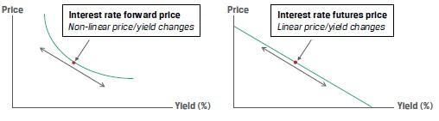
Pricing and valuation of futures interest rate futures
We see that the percentage price change is greater (in absolute value) when MRR falls than when it rises，which is called convexity bias.
The discounting feature of the FRA, which is not present in the futures contract, leads to a convexity bias that is greater for longer discounting periods

Slide 86
practices
One of Ace’s investor clients has entered a long six-month forward transaction with Ace on 100 shares of Xenaliya (XLYA), a non-dividend-paying technology stock. The stock’s spot price per share, S0, is €85, and the risk-free rate is a constant 1% for all maturities. Ace has hedged the client transaction with a long six-month XLYA futures contract at a price f0(T) of €85.42 and posted initial margin of €1,000. Three months after the forward and futures contracts are initiated, XYLA announces a strategic partnership with a major global technology firm, and its spot share price jumps €15 on the day’s trading to close at €123. Which of the following statements best characterizes the impact of the day’s trading on the MTM value of the forward versus the futures contract?
A. Ace’s client realizes an MTM gain of approximately €1,500 (= €15 × 100) on its margin account, which Ace must deposit at the end of the day to cover its margin call.
B. Ace’s client benefits from an MTM unrealized gain on its forward contract with Ace, and Ace has a corresponding MTM gain of approximately €1,500 (= €15 × 100) deposited in its margin account by the exchange.
C. Because Ace has entered a hedge of its client’s long forward position on XLYA by executing a futures contract with otherwise identical terms, the two contract MTM values exactly offset one another and no cash is exchanged on either transaction.

Slide 87
Pricing and valuation of derivatives
Pricing and valuation of forward
Forward rate agreement
Pricing and valuation of futures
Pricing and valuation of swap
Pricing and valuation of option
Put-call parity
One-period binominal model

Slide 88
Pricing and valuation of swap
A swap contract is an agreement between two parties to exchange a series of future cash flows, while a forward contract is an agreement for a single exchange of value at a later date.
Interest rate swaps are similar to forwards in that both contracts are firm commitments with symmetric payoff profiles and no cash is exchanged at inception, but they differ in that the fixed swap rate is constant, whereas a series of forward contracts has different forward rates at each maturity.
FRA has a single settlement, which occurs at the beginning of an interest period, while a standard swap has periodic settlements, which occur at the end of each respective period.

Slide 89
Pricing and valuation of swap
Years to maturity | Zero rate
1 | 2.3960%
2 | 3.4197%
3 | 4.0005%
IFR_{0,1}=2.3960%
IFR_{1,1} (1+2.3960%)*(1+IFR_{1,1})=(1+3.4197%)² IFR_{1,1}=4.4536%
IFR_{2,1} (1+3.4197%)²*(1+IFR_{2,1})=(1+4.0005%)³ IFR_{2,1}=5.1719%

Slide 90
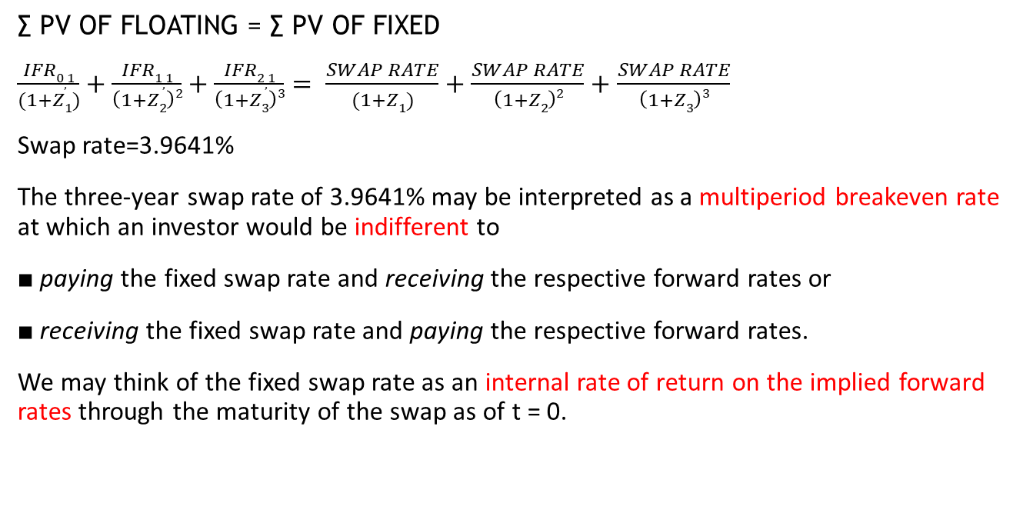
Pricing and valuation of swap
∑ PV OF FLOATING = ∑ PV OF FIXED
$\frac{IFR0,1}{(1+Z1)}+\frac{IFR1,1}{\left(1+Z2\right)2}+\frac{IFR2,1}{\left(1+Z3\right)3}= \frac{SWAP RATE}{(1+Z1)}+\frac{SWAP RATE}{\left(1+Z2\right)2}+\frac{SWAP RATE}{\left(1+Z3\right)3}$
Swap rate=3.9641%
The three-year swap rate of 3.9641% may be interpreted as a multiperiod breakeven rate at which an investor would be indifferent to
■ paying the fixed swap rate and receiving the respective forward rates or
■ receiving the fixed swap rate and paying the respective forward rates.
We may think of the fixed swap rate as an internal rate of return on the implied forward rates through the maturity of the swap as of t = 0.

Slide 91
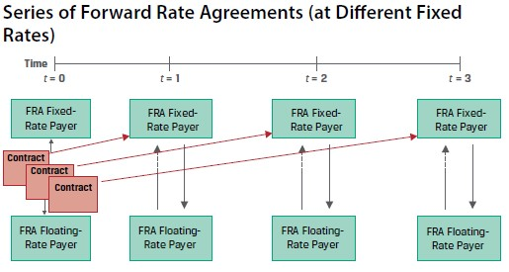
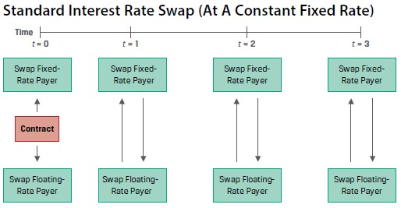
Pricing and valuation of swap

Slide 92
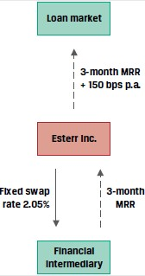
Pricing and valuation of swap
Derivative end users, such as issuers and investors, tend to use swaps more often than individual interest rate forward contracts for a number of reasons. For example, the ability to match cash flows of underlying assets or liabilities allows issuers to transform their exposure profile.
Under the swap arrangement, Esterr can fix its interest expense for the term loan and avoids the administrative burden of multiple forward contracts at different forward rates.

Slide 93
Pricing and valuation of swap
Using swaps to manage fixed-income exposure:
Given their greater liquidity than and similar benchmark exposure profile to individual bond positions.
For example, if interest rates are expected to fall, a portfolio manager may choose to receive fixed on a swap rather than purchase underlying bonds to realize a gain in a lower rate environment.
If an investor may decrease portfolio duration by entering this position in a swap contract fixed rate payer (floating rate receiver)

Slide 94
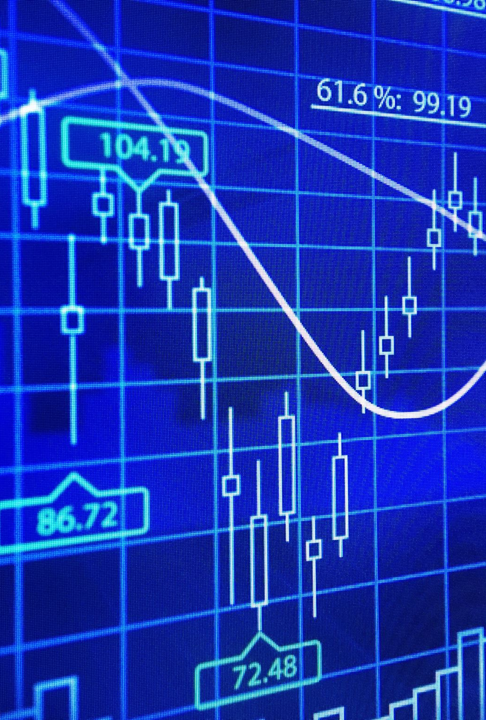
Pricing and valuation of swap
A rise in the expected forward rates after inception will increase the present value of floating payments, while the fixed swap rate will remain the same.
∑ PV(floating payment) > ∑ PV(fixed payment)
Long(floating receiver fixed payer): MTM gain
Short(fixed receiver floating payer): MTM loss
A decline in the expected forward rates after inception will reduce the present value of floating payments, while the fixed swap rate will remain the same.
∑ PV(floating payment) < ∑ PV(fixed payment)
Long(floating receiver fixed payer): MTM loss
Short(fixed receiver floating payer): MTM gain

Slide 95
Pricing and valuation of swap
Period | IFR | RATE
1 | IFR_{0,3m} | 0.50%
2 | IFR_{3m,3m} | 0.74%
3 | IFR_{6m3m} | 0.98%
4 | IFR_{9m,3m} | 1.22%
5 | IFR_{12m,3m} | 1.46%
6 | IFR_{15m,3m} | 1.70%
7 | IFR_{18m,3m} | 1.94%
8 | IFR_{21m,3m} | 2.18%
9 | IFR_{24m,3m} | 2.43%
10 | IFR_{27m,3m} | 2.67%
11 | IFR_{30m,3m} | 2.91%
12 | IFR_{33m,3m} | 3.15%
13 | IFR_{36m,3m} | 3.39%
14 | IFR_{39m,3m} | 3.78%
Esterr entered a 3.5-year CAD250 million interest rate swap contract under which it pays a fixed quarterly swap rate of 2.05% and receives three-month CAD MRR. The fixed swap price of 2.05% paid by Esterr remains constant over the life of the contract.
We first consider the passage of time with no change to expected interest rates. That is, the MRR sets each period based on the implied forward rates at trade inception.
Period 1: –CAD968,750 = (0.5% – 2.05%) × CAD250 million × 0.25
Period 2: –CAD818,750 = (0.74% – 2.05%) × CAD250 million × 0.25.

Slide 96
Pricing and valuation of swap
What is the swap MTM value from Esterr’s perspective immediately after the second periodic settlement if forward rates remain unchanged?
As we move forward in time with no change to interest rate expectations, the present value of remaining floating payments rises above the present value of fixed payments at 2.05%, as Esterr has made a net settlement payment in the first two periods.

Slide 97
Practices
Periods | Zero rates
1 | 2.2727%
2 | 3.0323%
3 | 3.6355%
At time t = 0, Ace observes the following zero rates over three periods: Which of the following best describes how Ace arrives at a three-period par swap rate (s3)?
A. Since the par swap rate represents the fixed rate at which the present value of fixed and future cash flows equal one another, we discount each zero rate back to the present using zero rates and solve for s3 to get 2.961%.
B. Since the par swap rate represents the fixed rate at which the present value of fixed and future cash flows equal one another, we first solve for the implied forward rate per period using zero rates, then discount each implied forward rate back to the present using zero rates, and solve for s3 to get 3.605%.
C. Since the par swap rate represents the fixed rate at which the present value of fixed and future cash flows equal one another, we first solve for the implied forward rate per period using zero rates, then discount each zero rate back to the present using implied forward rates, and solve for s3 to get 3.009%.

Slide 98

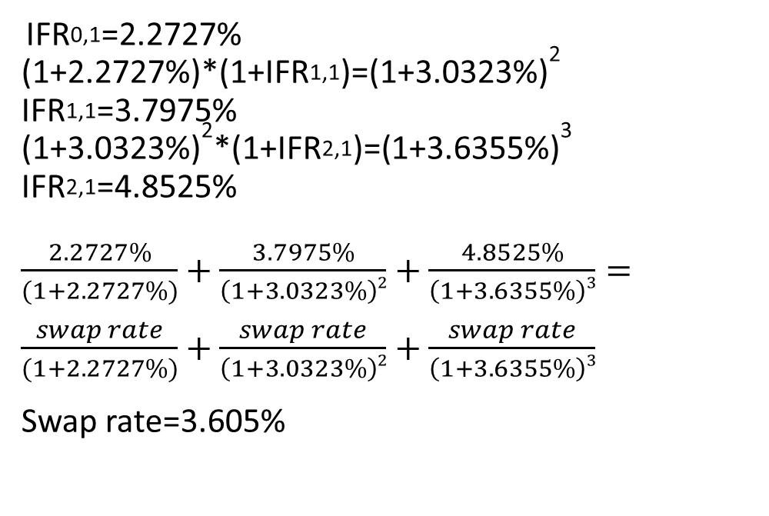
Practices
IFR_{0,1}=2.2727%
(1+2.2727%)*(1+IFR_{1,1})=(1+3.0323%)²
IFR_{1,1}=3.7975%
(1+3.0323%)²*(1+IFR_{2,1})=(1+3.6355%)³
IFR_{2,1}=4.8525%
$\frac{2.2727\%}{(1+2.2727\%)}+\frac{3.7975\%}{\left(1+3.0323\%\right)2}+\frac{4.8525\%}{\left(1+3.6355\%\right)3}=$
$\frac{swap rate}{(1+2.2727\%)}+\frac{swap rate}{\left(1+3.0323\%\right)2}+\frac{swap rate}{\left(1+3.6355\%\right)3}$
Swap rate=3.605%

Slide 99
Practices
Ace’s issuer client has swapped its outstanding fixed-rate debt to floating to match asset portfolio cash flows that generate an MRR-based return. Which of the following statements best describes how Ace’s MTM credit exposure to the issuer changes if interest rates rise immediately following trade inception?
A. Since the client receives fixed and pays floating swap, it faces an MTM loss on the transaction as rates rise, increasing Ace’s MTM exposure to the client.
B. Since the client receives fixed and pays floating swap, it faces an MTM gain on the transaction as rates rise, decreasing Ace’s MTM exposure to the client.
C. Since the swap’s value is equal to the current settlement plus future expected settlement amounts, we do not have enough information to determine whether Ace’s MTM exposure to the client increases or decreases.

Slide 100
Pricing and valuation of derivatives
Pricing and valuation of forward
Forward rate agreement
Pricing and valuation of futures
Pricing and valuation of swap
Pricing and valuation of option
Put-call parity
One-period binominal model

Slide 101
Pricing and valuation of option
This lesson focuses solely on European options with no additional cost or benefit of owning the underlying asset.
An option’s value comprises its exercise value and its time value. The exercise value is the option’s value if it were immediately exercisable, while the time value captures the possibility that the passage of time and the variability of the underlying price will increase the profitability of exercise at maturity.
Option value = exercise value + time value
Call option exercise value: MAX(0, S_{t}-X/(1+r)^{T-t})
Put option exercise value: MAX(0,X/(1+r)^{T-t}-S_{t})

Slide 102
Pricing and valuation of option
Consider the earlier case of a one-year put option with an exercise price (X) of EUR 1,000, an initial price of EUR 990, and a risk-free rate of 1%. What is the exercise value of the option in six months if the spot price (St) equals EUR 950?
Exercise value=MAX(0,1000/(1+1%)^{0.5}-950)=45.04

Slide 103
Pricing and valuation of option
While the exercise value of an option reflects its current payoff, an additional component of an option’s value is derived from its remaining time to maturity. Although European options can be exercised only at maturity, they can be purchased or sold prior to maturity at a price (c_{t} or p_{t}, for a call or put, respectively) that reflects the option’s future expected payoff.
The time value of an option is equal to the difference between the current option price and the option’s current payoff (or exercise value).
c_{t} = Max(0,S_{t}-X/(1+r)^{T-t}) + Time value
p_{t} = Max(0,X/(1+r)^{T-t}-S_{t}) + Time value
The time value of an option is always positive but declines to zero at maturity, a process referred to as time value decay.

Slide 104
Pricing and valuation of option
Example 1 showed that a one-year put option with an exercise price (X) of EUR 1,000 had an exercise value of EUR 45.04 with six months remaining to maturity when the spot price (St) was EUR 950. If we observe a current put option price (pt) of EUR 50, what is the time value of the put option?
Option value = exercise value + time value
50 = 45.04 + time value
Time value = 4.96

Slide 105
Pricing and valuation of option
Moneyness | Call option | Put option
In the money(ITM) | S_{t}>X | S_{t}<X
At the money(ATM) | S_{t}=X | S_{t}=X
Out of the money(OTM) | S_{t}<X | S_{t}>X
Option moneyness expresses the relationship between the underlying price and the exercise price. A put or call option is “at the money” when the underlying price equals the exercise price. An option is more likely to be exercised if it is “in the money”—with an underlying price above (for a call) or below (for a put) the exercise price—and less likely to be exercised if it is “out of the money.”

Slide 106
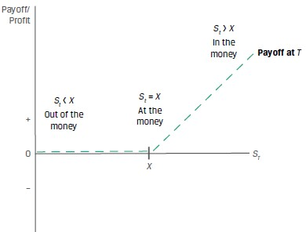
Pricing and valuation of option
Also, the degree to which an option is in or out of the money affects the sensitivity of an option’s price to underlying price changes. For example, a so-called deep-in-the-money option, or one that is highly likely to be exercised, usually demonstrates a nearly one-to-one correspondence between option price and underlying price changes. A deep-out-of-the-money option, which is very unlikely to be exercised, demonstrates far less option price sensitivity for a given underlying price change.

Slide 107
Pricing and valuation of option
C_{t} lower bound = Max(0,S_{t}-X/(1+r)^{T-t})
C_{t} upper bound = S_{t}
The call buyer will not pay more for the right to purchase an underlying than the price of that underlying.
P_{t} lower bound = Max(0,X/(1+r)^{T-t}-S_{t})
P_{t} upper bound = X

Slide 108
Pricing and valuation of option
X=90,一年月后到期的看涨期权，S₀=100，rf=5%，执行价格现值=85.71，exercise value=14.29，C₀=10元，如何套利
T=0 | 一年后标的资产价格大于90，行权 | 一年后标的资产价格小于90，不行权
借入标的资产卖出（+100） | 以执行价格90买入标的资产（-90） | 以较低的市场价格买入标的资产（-88）
买入看涨期权（-10） | 归还标的资产 | 归还标的资产
存90进银行（-90） | 本息和94.5（+94.5） | 本息和94.5（+94.5）
净流入=0 | 净流入=94.5-90=4.5 | 净流入=94.5-88=6.5

Slide 109
Pricing and valuation of option
In order to replicate the call option at contract inception (t = 0), we also must borrow at the risk-free rate, r, and use the proceeds to purchase the underlying at price of S0.
Exercise (ST > X): Sell the underlying for ST and use the proceeds to repay X.
No exercise (ST < X): No settlement is required.
The non-linear payoff profile of an option requires that the replicating transaction be adjusted as this likelihood changes.
In order to replicate the put option at contract inception (t = 0), we must sell the underlying short at a price of S0 and lend the proceeds at the risk-free rate, r.
Exercise (ST < X): Purchase the underlying for ST from the proceeds of the risk-free loan.
No exercise (ST > X): No settlement is required.

Slide 110
Pricing and valuation of option
Factor | Call value | Put value
Value of the underlying | + | -
Exercise price | - | +
Time to expiration | + | +/-
Risk free interest rate | + | -
Volatility of the underlying | + | +
Income/cost related to owning the underlying | -/+ | +/-

Slide 111
practices
The Viswan Family Office (VFO) owns non-dividend-paying shares of Biomian Limited that are currently priced (S0) at INR 295 per share. VFO’s CIO is considering an offer to sell shares at a forward price (F0(T)) of INR 300.84 per share in six months based on a risk-free rate of 4%. You have been asked to advise on the purchase of a put option or the sale of a call option with an exercise price (X) equal to the forward price (F0(T)) as alternatives to a forward share sale.
1.VFO is considering the purchase of the put option to hedge against a decline in Biomian’s share price. Which of the following statements best characterizes the trade-off between the put and the forward based on no-arbitrage pricing?
A. The gain on the forward sale will equal the purchased put option’s profit at maturity provided the put option ends up in the money at maturity.
B. The loss on the forward sale will exceed the loss on the purchased put at maturity if Biomian’s share price exceeds the forward price by more than the initial put premium paid.
C. We do not have enough information to answer this question, since we do not know the time value of the option at maturity.

Slide 112
practices
2.In comparing the sold call and purchased put strategies at the forward price, VFO’s CIO is concerned about how an immediate increase in the volatility of the underlying Biomian shares might affect option value. Which of the following statements about this volatility change and its effect on strategy is most accurate?
A. An increase in the volatility of the underlying shares has the same effect on call and put option values, so this change should not affect VFO’s strategy decision.
B. Since changes in the volatility of the underlying shares have the opposite effect on put versus call options, this change will increase the attractiveness of the put strategy versus the call strategy.
C. An increase in the volatility of the underlying shares will increase both the cost of the purchased put strategy and the premium received on the sold call strategy, so this change will increase the attractiveness of the call strategy versus the put strategy.

Slide 113
Pricing and valuation of derivatives
Pricing and valuation of forward
Forward rate agreement
Pricing and valuation of futures
Pricing and valuation of swap
Pricing and valuation of option
Put-call parity
One-period binominal model

Slide 114
Put-call parity
Put–call parity establishes a relationship that allows the price of a call option to be derived from the price of a put option with the same underlying details and vice versa.
Put–call parity holds for European options with the same exercise price and expiration date, representing a no-arbitrage relationship between put option, call option, underlying asset, and risk-free asset prices.
P₀+S₀ =C₀+X/(1+r)^{T}
This strategy of holding an underlying asset and purchasing a put on the same asset is sometimes called a protective put.
The combination of a purchased call and a risk-free bond is known as a fiduciary call.

Slide 115
Put-call parity
Portfolio position | S_{T}>X | S_{T}=X | S_{T}<X
Protective put:
Underlying asset | S_{T} | S_{T} | S_{T}
Put option | 0 | 0 | X-S_{T}
Total: | S_{T} | S_{T} | X
Fiduciary call:
Call option | S_{T}-X | 0 | 0
Risk-free asset(bond) | X | X | X
Total: | S_{T} | X | X

Slide 116
practices
The Viswan Family Office (VFO) held non-dividend-paying Biomian shares currently priced (S₀) at INR295 per share. VFO is considering the purchase of a six-month put on Biomian shares at an exercise price, X, of INR265. If VFO’s chief investment officer observes a traded six-month call option price of INR59 per share for the same INR265 exercise price, what should he expect to pay for the put per share if the relevant risk-free rate is 4%?
If the put option is currently priced at INR30, identify the arbitrage opportunity and the steps to earn a riskless profit.

Slide 117
Put-call parity
Replication of individual position under put-call parity
Position | Underlying(S₀) | Risk free bond(X/(1+r)^{T}) | Call option(C₀) | Put option(P₀)
Underlying(S₀) | - | long | long | Short
Risk free bond(X/(1+r)^{T}) | long | - | short | Long
Call option(C₀) | long | short | - | Long
Put option(P₀) | short | long | Long | -
Replication of covered call
S₀-C₀=X/(1+r)^{T}-P₀

Slide 118
PUT–CALL FORWARD PARITY
A long underlying asset position can be replicated by entering a long forward contract and purchasing the risk-free asset(bond)with a face value equal to the forward price.
The combination of the synthetic underlying position and a purchased put on the underlying is known as a synthetic protective put.
Combining the synthetic asset with the put–call parity relationship—S₀, substituting the present value of F₀(T) for S₀ in put-call parity Equation —we have what is referred to as put–call forward parity:
F₀(T)/(1 + r)^{T} + P₀ = C₀ + X/(1 + r)^{T}

Slide 119
PUT–CALL FORWARD PARITY
Synthetic protective put vs fiduciary call
Portfolio position | S_{T}>X | S_{T}=X | S_{T}<X
Synthetic protective put
Put option | 0 | 0 | X-S_{T}
Long Forward | S_{T}-F₀(T) | S_{T}-F₀(T) | S_{T}-F₀(T)
Risk free bond | F₀(T) | F₀(T) | F₀(T)
Total | S_{T} | S_{T} | X
Fiduciary call
Call option | S_{T}-X | 0 | 0
Risk free asset | X | X | X
Total | S_{T} | X | X

Slide 120
Put-call parity applications: firm value
When the debt matures at T, the firm’s debt and assets are distributed between shareholders and debtholders with two possible outcomes depending on the firm’s value at time T (V_{T}):
1. Solvency (V_{T} > D): If the value of the firm (V_{T}) exceeds the face value of the debt, or V_{T} > D, at time T, we say the firm is solvent and able to return capital to both its shareholders and debtholders.
● Debtholders receive D and are repaid in full.
● Shareholders receive the residual: E_{T} = V_{T} – D.
2. Insolvency (V_{T} < D): If the value of the firm (V_{T}) is below the face value of the debt, or V_{T} < D, at time T, we say the firm is insolvent. In the event of insolvency, shareholders receive nothing and debtholders are owed more than the value of the firm’s assets. Debtholders therefore receive VT to settle their debt claim of D at time T.
● Debtholders have a priority claim on assets and receive V_{T} < D.
● Shareholders receive the residual, E_{T} = 0.

Slide 121
Put-call parity applications: firm value
■ shareholder payoff is max(0, V_{T} – D)
■ debtholder payoff is min(V_{T}, D)
Shareholders hold a call option on firm value(V_{T}) with an exercise price of D.
Debtholders hold a long position in a risk-free bond (D) and have sold a put option to shareholders on firm value (V_{T}) with an exercise price of D.
Revisiting the put–call parity relationship, S₀ + P₀ = C₀ + PV(X), we may substitute the value of the firm at time 0 (V₀) for the underlying asset (S₀), substitute the debt (D) for the risk-free bond (X), and solve for V₀ as follows:
V₀ + P₀ = C₀ + PV(D)
V₀ = C₀ + PV(D) – P₀

Slide 122
Pricing and valuation of derivatives
Pricing and valuation of forward
Forward rate agreement
Pricing and valuation of futures
Pricing and valuation of swap
Pricing and valuation of option
Put-call parity
One-period binomial model

Slide 123
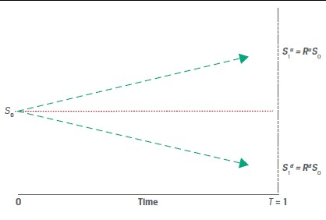
One-period binomial model
R^{u}=S₁^{u}/S₀ >1
R^{d}=S₁^{d}/S₀ <1

Slide 124
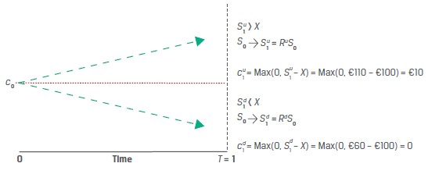
One-period binomial model
For example, setting S₀=80 ,S₁^{d}= €60 and S₁^{u} = €110. Then, R^{u} = 1.375 and R^{d} = 0.75.rf=5%

Slide 125

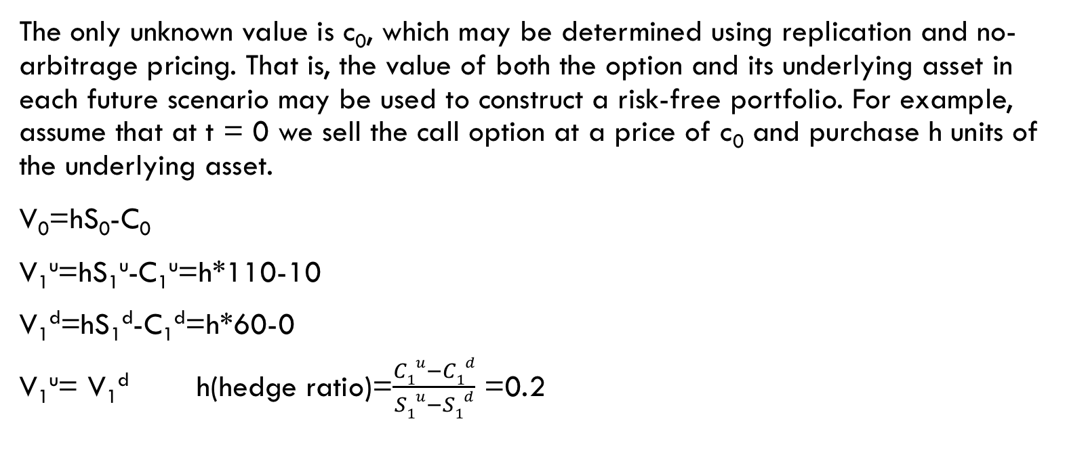
no-arbitrage pricing
The only unknown value is c₀, which may be determined using replication and no-arbitrage pricing. That is, the value of both the option and its underlying asset in each future scenario may be used to construct a risk-free portfolio. For example, assume that at t = 0 we sell the call option at a price of c₀ and purchase h units of the underlying asset.
V₀=hS₀-C₀
V₁^{u}=hS₁^{u}-C₁^{u}=h*110-10
V₁^{d}=hS₁^{d}-C₁^{d}=h*60-0
V₁^{u}= V₁^{d} h(hedge ratio)=$\frac{C1u−C1d}{S1u−S1d}$ =0.2

Slide 126
no-arbitrage pricing
For each call option unit sold, we buy 0.2 units of the underlying asset (or for each underlying asset unit, we must sell 5 call options to equate the portfolio values at t=1).
V₁^{u}= V₁^{d} =12
For an annual risk-free rate of 5%
V₀= V₁^{u}/(1+rf) = 12/(1+5%)=11.43
V₀=h*S₀-C₀ = 0.2*80-C₀=11.43
C₀=4.57

Slide 127

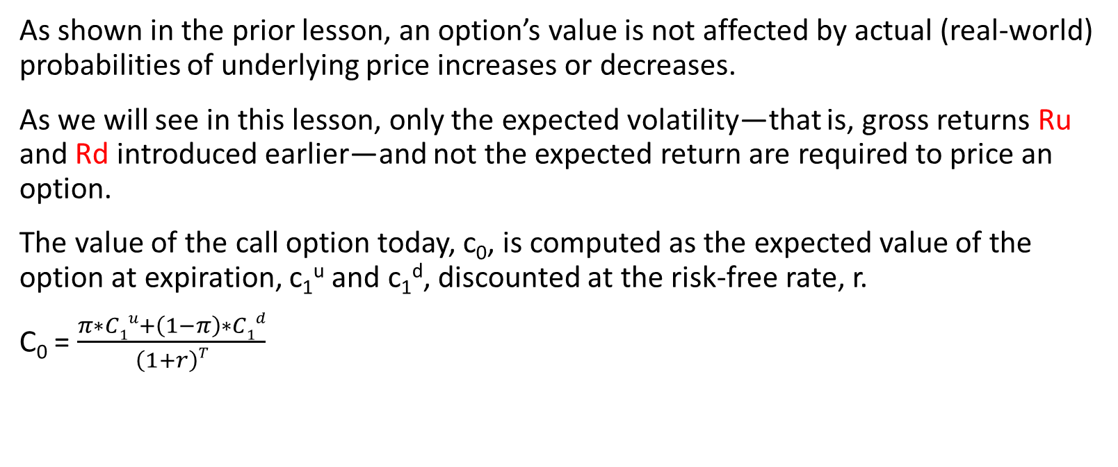
RISK NEUTRAl pricing
As shown in the prior lesson, an option’s value is not affected by actual (real-world) probabilities of underlying price increases or decreases.
As we will see in this lesson, only the expected volatility—that is, gross returns Ru and Rd introduced earlier—and not the expected return are required to price an option.
The value of the call option today, c₀, is computed as the expected value of the option at expiration, c₁^{u} and c₁^{d}, discounted at the risk-free rate, r.
C₀ = $\frac{π∗C1u+\left(1−π\right)∗C1d}{\left(1+r\right)T}$

Slide 128
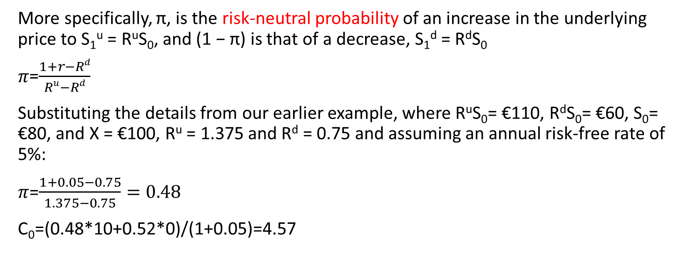
RISK NEUTRAl pricing
More specifically, π, is the risk-neutral probability of an increase in the underlying price to S₁^{u} = R^{u}S₀, and (1 − π) is that of a decrease, S₁^{d} = R^{d}S₀
𝜋=$\frac{1+r−Rd}{Ru−Rd}$
Substituting the details from our earlier example, where R^{u}S₀= €110, R^{d}S₀= €60, S₀= €80, and X = €100, R^{u} = 1.375 and R^{d} = 0.75 and assuming an annual risk-free rate of 5%:
$π$=$\frac{1+0.05−0.75}{1.375−0.75}=0.48$
C₀=(0.48*10+0.52*0)/(1+0.05)=4.57

Slide 129
practices
Privatbank Kleinert KGaA, a private wealth manager in Munich, has a number of clients with large holdings in the German fintech firm SparCoin AG. Kleinert’s analyst is concerned about a drop in SparCoin’s share price in the next year and is recommending to clients that they consider purchasing a one-year put with an exercise price of €100. SparCoin’s spot price (S0) is €105.25, and it pays no dividends. The risk-free rate is 0.37%.

Slide 130
Practices
1. Kleinert’s analyst estimates a 50-50 chance that the price of SparCoin will either increase by 12% or decline by 10% at the put option’s expiration date. Which of the following statements best describes the no-arbitrage option price implied by this assumption?
A. Since there is a 50% chance that the stock will fall to €94.73, there is a 50-50 chance of a €5.27 payout upon exercise and the no-arbitrage put is therefore worth €2.64 (= €5.27 / 2).
B. Since there is a 50% chance that the stock will fall to €94.73, there is a 50-50 chance of a €5.27 payout upon exercise and given the risk-neutral probability of 0.47, the no-arbitrage put price is €2.48 (= €5.27 × 0.47).
C. Since there is a 50% chance that the stock will fall to €94.73 and the risk-neutral probability is 0.47, the no-arbitrage put price is €2.78 (= €5.27 ×{[1 – 0.47]/1.0037}).

Slide 131
practices
2. If Kleinert’s clients observe that the one-year put option with a €100 exercise price is trading at €2.50, which of the following statements best describes how Kleinert’s clients could take advantage of this to earn a risk-free return greater than 0.37% over the year.
A. Kleinert should purchase the put option and also purchase approximately 0.23 shares per option to match the hedge ratio.
B. Kleinert should purchase the put option and purchase 50% of the underlying shares given the 50-50 chance the stock will fall and the put option exercised.
C. Kleinert should purchase the put option and purchase 47% of the underlying shares to match the risk-neutral probability of put exercise.

Slide 132
derivatives
Arbitrage and replication
Derivatives market and underlying asset
Derivatives benefit, risk, and issuer and investor uses

Slide 133
arbitrage
In the case of a derivative contract whose value is derived from future cash flows associated with the price of an underlying asset, arbitrage opportunities arise either if two assets with identical future cash flows trade at different prices or if an asset with a known future price does not trade at the present value of its future price determined using an appropriate discount rate.
Identical assets or assets with identical cash flows traded at the same time must have the same price (S₀A = S₀B).
Assets with a known future price must have a spot price that equals the future price discounted at the risk-free rate (S₀ = F_{T}(1 + r)^{–T}).

Slide 134

example
For example, assume the two assets are zero-coupon bonds with identical features and the same issuer. Both bonds mature on the same future date with a payoff of par and have the same risk of default between now and the maturity date.
1. Bond A has a price of EUR99 at time t = 0 (S₀A = EUR99).
2. Bond B has a price of EUR99.15 at time t = 0 (S₀B = EUR99.15).
3. Both bonds have an expected future price of EUR100 (S_{T}A = S_{T}B = EUR100).

Slide 135
example
In an earlier lesson, Procam Investments entered into a contract to buy 100 ounces of gold at an agreed-upon price of USD1,792.13 per ounce in three months. In this example, Procam does the opposite trade, given a discrepancy between spot and discounted known future gold prices. Assume that today’s spot gold price (S0) is USD1,770 per ounce, and the annualized risk-free interest rate (r) is 2%. For purposes of this example, we assume that Procam can borrow at the risk-free rate and gold may be stored at no cost.

Slide 136
replication
Replication is a strategy in which a derivative’s cash flow stream may be recreated using a combination of long or short positions in an underlying asset and borrowing or lending cash.
Long Forward: borrows at the risk-free rate, buys the underlying asset, and holds it until time T.
Short Forward: sells the underlying asset, lends at the risk-free rate ,
Risk-Free Trade Replication: Long Asset, Short Forward

Slide 137
EXAMPLE
Here we change the assumption about today’s spot gold price (S0). Specifically, the spot gold price has risen to USD1,783.28 (= USD1,792.13(1.02)^{–0.25}) to eliminate the earlier arbitrage opportunity when the spot price was USD1,770. Assume again that the risk-free interest rate (r) is 2% and gold can be stored at no cost.
1. Long forward commitment (agree to buy at F₀(T) at t = T)
2. Borrow and purchase (borrow S₀ and buy asset at S₀ at t = 0):

Slide 138
example
Procam Investments buys 100 ounces of gold at today’s spot price (S0) of
USD1,783.28 and simultaneously enters a forward commitment to sell gold at
the forward price, F0(T), of USD1,792.13. Again, we assume that gold can be
stored at no cost, and here we solve for Procam’s rate of return.

Slide 139
derivatives
Arbitrage and replication
Derivatives market and underlying asset
Derivatives benefit, risk, and issuer and investor uses

Slide 140

Derivatives markets
A derivative is a financial instrument that derives its value from the performance of an underlying asset.
Stand-alone derivative: A distinct derivative contract, such as a derivative on a stock or bond.
Embedded derivative: A derivative within an underlying , such as callable, puttable, or convertible bond.

Slide 141
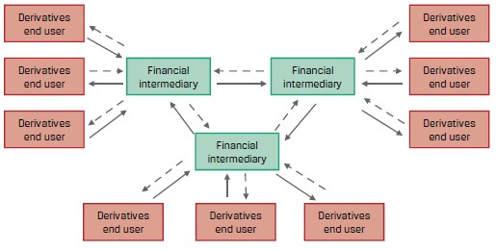
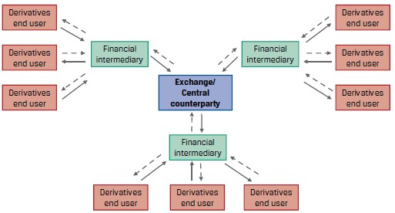
Derivative markets
OTC derivative markets
Exchange treaded derivative market

Slide 142
Derivative markets
Derivative market:
Over-the-counter(OTC): OTC derivative markets involve contracts entered between derivatives end users and dealers, or financial intermediaries, such as commercial banks or investment banks.
Exchanged-traded derivative(ETD): An exchange-traded derivative (ETD) includes futures, options, and other financial contracts available on exchanges.
Clearing is the exchange’s process of verifying the execution of a transaction, exchange of payments, and recording the participants.
Settlement involves the payment of final amounts and/or delivery of securities or physical commodities between the counterparties based upon exchange rules.

Slide 143
Derivative markets
Following the 2008 global financial crisis, global regulatory authorities instituted a central clearing mandate for most OTC derivatives. This mandate requires that a central counterparty (CCP) assume the credit risk between derivative counterparties, one of which is typically a financial intermediary. CCPs provide clearing and settlement for most derivative contracts.
However, the systemic credit risk transfer from financial intermediaries to CCPs also leads to centralization and concentration of risks.

Slide 144
Derivative underlying
Derivative underlying :
Equity: Equity derivatives usually reference an individual stock, a group of stocks, or a stock index.
Fixed-income instrument: Bonds are a widely used underlying, and related derivatives include option, forward, futures, and swap. A market reference rate(MRR) is the most common interest rate underlying used in interest rate swaps.
Currency
Commodity: Soft commodities are agricultural products, such as cattle and corn, and hard commodities are natural resources, such as crude oil and metals.
Credit: Credit derivative contracts are based upon the default risk of a single issuer or a group of issuers in an index.
Other: Other derivative underlying include weather, cryptocurrencies, and longevity.

Slide 145
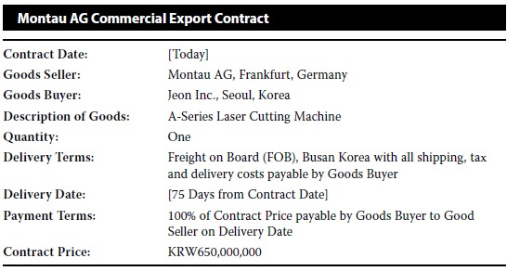
practices
Montau AG is a German capital goods producer that manufactures its products domestically and delivers its products to clients globally. Montau’s global sales manager shares the following draft commercial contract with his Treasury team:

Slide 146
practices
1.Which of the following types of derivative and underlyings are best suited to hedge Montau’s financial risk under the commercial transaction?
A. Montau AG should consider a firm commitment derivative with currency as an underlying, specifically the sale of KRW at a fixed EUR price.
B. Montau AG should consider a contingent claim derivative with the price of the machine as its underlying, specifically an A-series laser cutting machine.
C. Montau AG should consider a contingent claim derivative with currency as an underlying, specifically the sale of EUR at a fixed KRW price.

Slide 147
practices
2.Which of the following statements about the most appropriate derivative market to hedge Montau AG’s financial risk under the commercial contract is most accurate?
A. The OTC market is most appropriate for Montau, as it is able to customize the contract to match its desired risk exposure profile.
B. The ETD market is most appropriate for Montau, as it offers a standardized and transparent contract to match its desired risk exposure profile.
C. Both the ETD and OTC markets are appropriate for Montau AG to hedge its financial risk under the transaction, so it should choose the market with the best price.

Slide 148
derivatives
Arbitrage and replication
Derivatives market and underlying asset
Derivatives benefit, risk, and issuer and investor uses

Slide 149
Derivative benefits
Purpose | Description
Risk Allocation, Transfer, and Management | Allocate, trade, and/or manage underlying exposure without trading the underlying. Create exposures unavailable in cash markets.
Information Discovery | Deliver expected price in the future as well as expected risk of underlying.
Operational Advantages | Reduced cash outlay, lower transaction costs versus the underlying, increased liquidity and ability to “short”.
Market Efficiency | Less costly to exploit arbitrage opportunities or mispricing.

Slide 150
Derivative risks
Risk | Description
Greater Potential for Speculative Use | High degree of implicit leverage for some derivative strategies may increase the likelihood of financial distress.
Lack of Transparency | Derivatives add portfolio complexity and may create an exposure profile that is not well understood by stakeholders.
Basis Risk | Potential divergence between the expected value of a derivative instrument versus an underlying or hedged transaction
Liquidity Risk | Potential divergence between the cash flow timing of a derivative instrument versus an underlying or hedged transaction
Counterparty Credit Risk | Derivative instruments often give rise to counterparty credit exposure, resulting from differences in the current price versus the expected future settlement price.
Destabilization and Systemic Risk | Excessive risk taking and use of leverage in derivative markets may contribute to market stress, as in the 2008 financial crisis.

Slide 151
Issuer use of derivatives
Hedge accounting allows an issuer to offset a hedging instrument (usually a derivative) against a hedged transaction or balance sheet item to reduce financial statement volatility.
Hedge type | Description | Examples
Cash flow | Absorbs variable cash flow of floating-rate asset or liability (forecasted transaction) | Interest rate swap to a fixed rate for floating-rate debt FX forward to hedge forecasted sales
Fair value | Offsets fluctuation in fair value of an asset or liability | Interest rate swap to a floating rate for fixed-rate debt Commodity future to hedge inventory
Net investment | Designated as offsetting the FX risk of the equity of a foreign operation | Currency swap Currency forward

Slide 152
Investor use of derivatives
Investors use derivatives to replicate a cash market strategy, hedge a fund’ value against adverse movements in underlying, or modify or add exposures using derivatives, which in some cases are unavailable in cash markets.
The greater liquidity and reduced capital required to trade derivatives may lead an investor to replicate a desired position using a derivative rather than cash.
The flexibility to take short positions or to increase or otherwise modify exposure using derivatives beyond cash alternatives is an attractive feature for portfolio managers targeting excess returns by using a variety of strategies.
we find investors to be less focused than issuers on hedge accounting treatment, as an investment fund’s derivative position is typically marked to market each day and included in the daily net asset value (NAV) of the portfolio or fund. This also explains why investors tend to transact more frequently in standardized and highly liquid exchange-traded derivative markets than do issuers.

